Slide 1

Detrapping of BE-TOX 3D NAND Flash
- Modeling & TCAD simulation -
진명
1/9
School of Electrical Engineering, Seoul National University

Slide 2
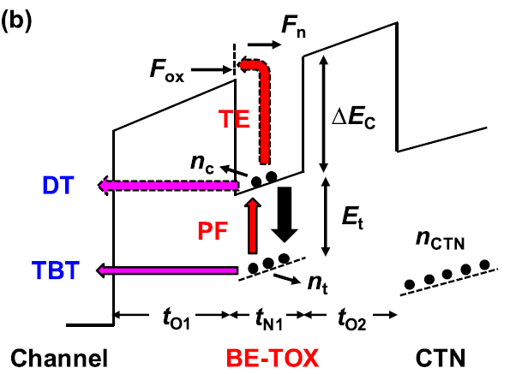
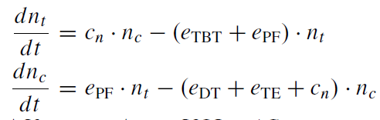
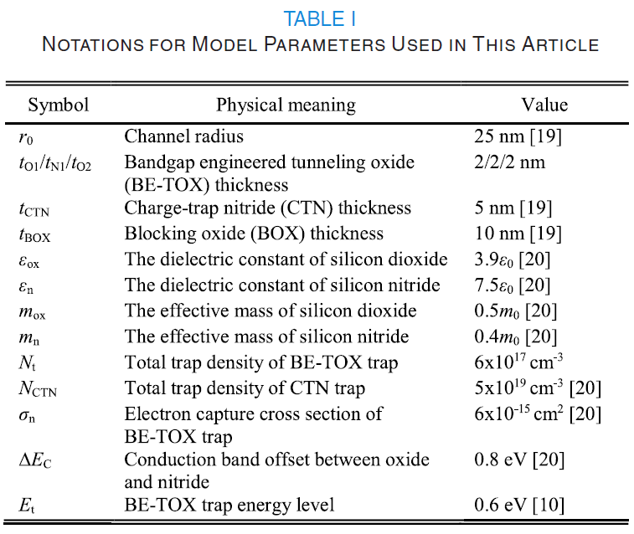

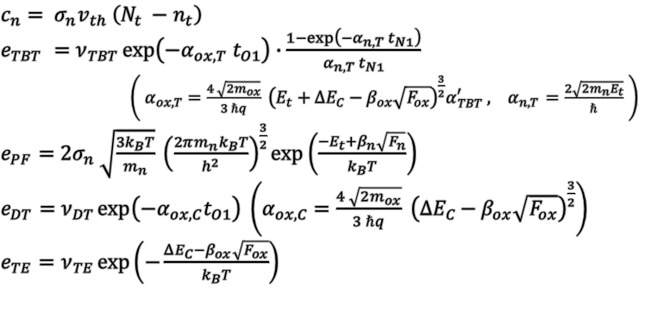
Detrapping Modeling & Equations
$c_{n}= σ_{n}v_{th} \left(N_{t} −n_{t}\right)$
$e_{TBT} =ν_{TBT}\exp\left(−α_{ox,T} t_{O1}\right)∙\frac{1−\exp\left(−α_{n,T} t_{N1}\right)}{α_{n,T} t_{N1}}$
$\left( α_{ox,T}=\frac{4 \sqrt{2m_{ox}}}{3 ℏq} {\left(E_{t}+ΔE_{C}−β_{ox}\sqrt{F_{ox}}\right)}^{\frac{3}{2}}α_{TBT}^{′} , { α}_{n,T }=\frac{2\sqrt{2m_{n}E_{t}}}{ℏ} \right)$
$e_{PF}=2σ_{n} \sqrt{\frac{3k_{B}T}{m_{n}}} {\left(\frac{2πm_{n}k_{B}T}{h^{2}}\right)}^{\frac{3}{2}}\exp\left(\frac{−E_{t}+β_{n}\sqrt{F_{n}}}{k_{B}T}\right)$
$e_{DT}=ν_{DT}\exp\left(−α_{ox,C}t_{O1}\right) \left(α_{ox,C}=\frac{4 \sqrt{2m_{ox}}}{3 ℏq} {\left(ΔE_{C}−β_{ox}\sqrt{F_{ox}}\right)}^{\frac{3}{2}}\right)$
$e_{TE}=ν_{TE}\exp\left(−\frac{ΔE_{C}−β_{ox}\sqrt{F_{ox}}}{k_{B}T}\right)$
Kim, Minsoo, and Hyungcheol Shin. IEEE Transactions on Electron Devices 68.7 (2021): 3339-3345.
2/9
School of Electrical Engineering, Seoul National University

Slide 3
Modeling Result (Example)
- Parameters are not yet calibrated
$τ:$ (saturation voltage) $×\left(1−e^{−1} ≈63\%\right)$ $\sim {10}^{−3\sim 4}\left[s\right]$
3/9
School of Electrical Engineering, Seoul National University

Slide 4
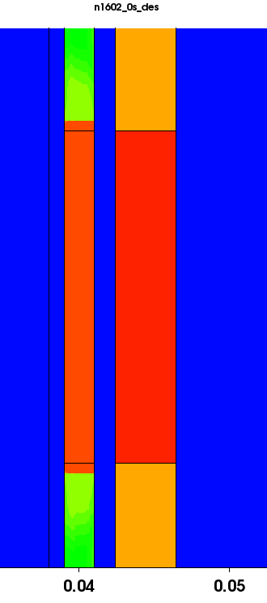
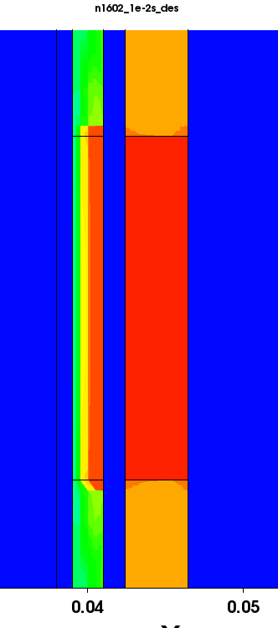
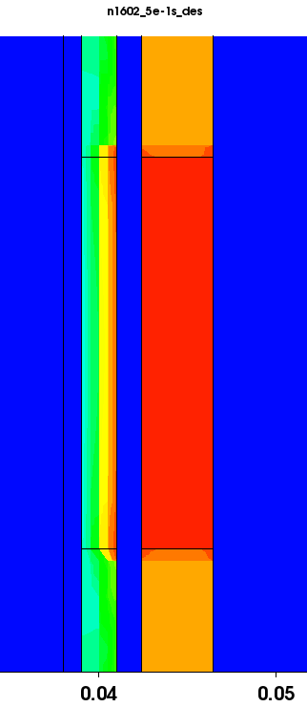
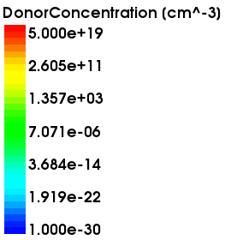
Observation of Detrapping in TCAD
0 [s] (initial)
0.01 [s]
0.5 [s]
4/9
School of Electrical Engineering, Seoul National University

Slide 5
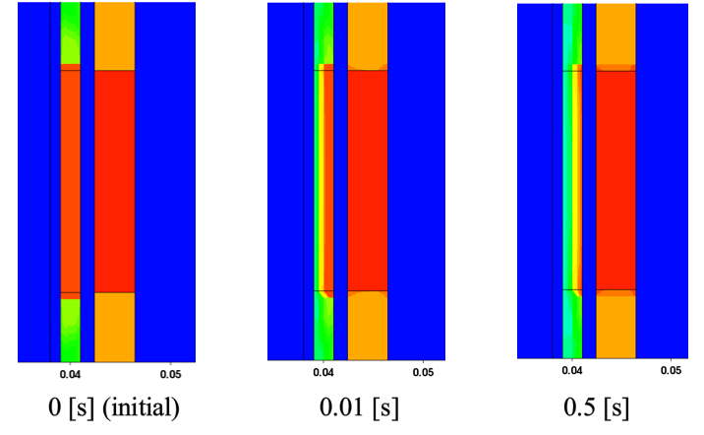
Observation of Detrapping in TCAD
Plot of Charged-trap distribution in BETOX-Nitride
5/9
School of Electrical Engineering, Seoul National University

Slide 6
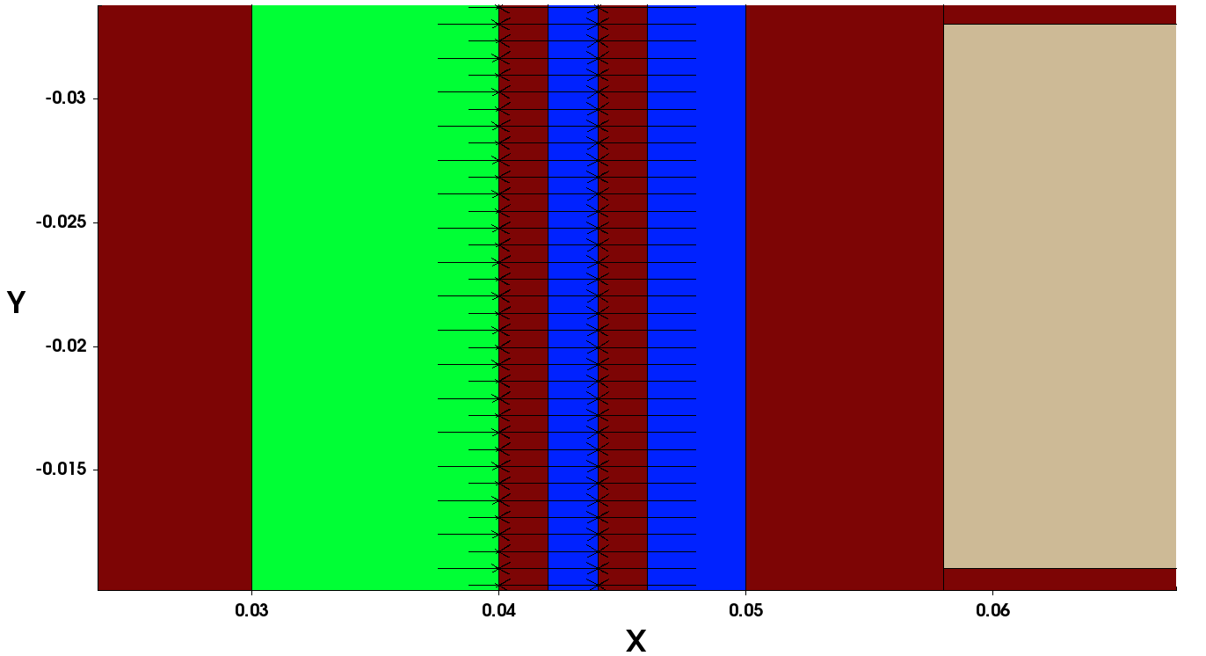
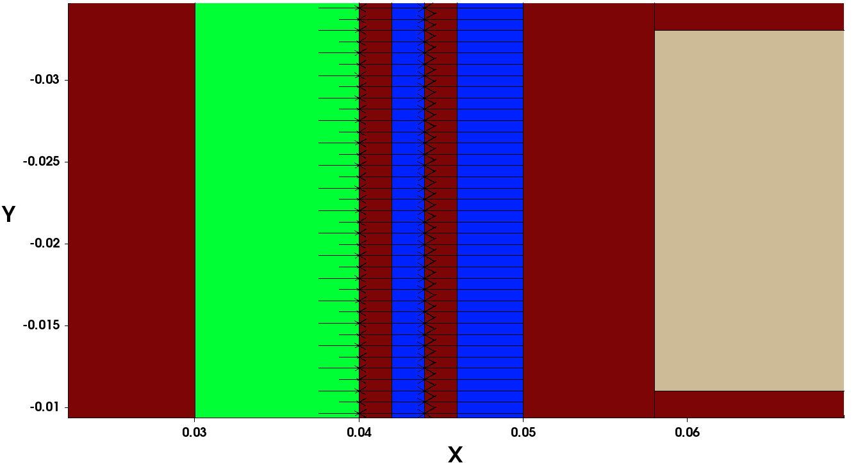
Application of Nonlocal tunneling Length
Nonlocal tunneling length = 4nm
Tunneling length
= 4nm
Nonlocal tunneling length = 6nm
Tunneling length
= 6nm
6/9
School of Electrical Engineering, Seoul National University

Slide 7
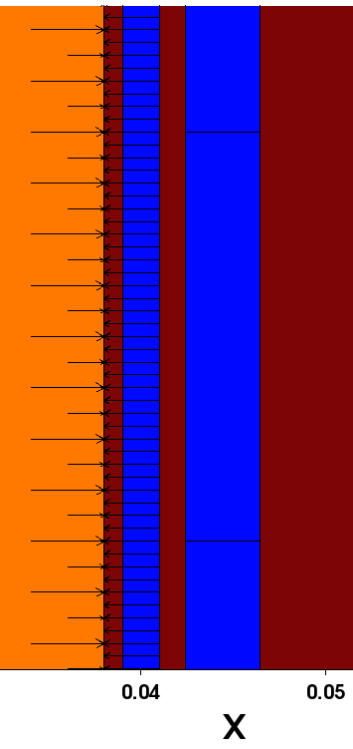
Application of Nonlocal tunneling Length
Long tunneling length (set: 6nm)
Short tunneling length (set: 4nm)
Detrap
Detrap
LM
LM
CTN
BarrierTunneling OFF
TAT
(6nm)
(6nm)
Detrap
+ TAT(ctn > BETOX > Si / ctn > Si)
+ LM
Detrap
+ LM
7/9
School of Electrical Engineering, Seoul National University

Slide 8

Modeling vs TCAD Result
Lateral Migration
Detrap
- Parameters are not yet calibrated
$τ$ $\sim {10}^{−3\sim 4}\left[s\right]$
8/9
School of Electrical Engineering, Seoul National University

Slide 9
Future Works
Separation of mechanisms within detrap (TBT, PF, DT, TE)
(After Separation) Model – TCAD calibration with fitting parameters
Observation of TAT (ctn > BETOX(Nitride) > Si-Sub) in retention mode.
9/9
School of Electrical Engineering, Seoul National University

